Slide 1
Managerial Economics
Yao Zhiyong
Fudan University
2010

Slide 2
Economics
A social science deals with the allocation of resources within and across firms, households, and other decision-making units.
The operation and organization of firms and industries, the determination of prices for factors and products, as well as the determinants of economic growth and development.

Slide 3
Economics
It analyzes production, consumption, investment, employment, trade, and government policies.
Both micro- and macro-economic analyses are essential in the decision making of households, firms, and governments.

Slide 4
Managerial Economics
From the management’s point of view
Focus on the decision making of the firm
Demand and Profit Maximization
Competitive market, price determination
Production, cost, perfect competition, monopoly pricing
Oligopoly, strategy, game theory
Incentive and organization theory

Slide 5
Managerial Economics
Address a lot of important questions:
1. What’s the market demand? How to estimate it? How to response to the change?
2. What mix of inputs should the firm use in its production?
3.How should the firm price its products to maximize profit?
4. Who are the firm’s competitors, and how are they likely to respond to the firm’s behavior?

Slide 6
DEMAND
Markets have two sides –those who are selling and those who are buying.
The behavior of the buyers is summarized in a demand function.

Slide 7
Factors that we expect to affect the demand for the good include:
    Population (n)
    Price of the good (p_{i})
    Price of other goods (p_{j})
    Income (y)
    Expectations of future prices
    Tastes (T)

Slide 8
Example: Alcohol in Sichuan
  Log B = K_{B} – 0.164log P_{B} – 20.23logY
  Log W = K_{W} – 0.539log P_{W} – 7.552logY
Log S = K_{S} – 0.452log P_{S} – 14.53logY
Log V = K_{V} – 0.707log P_{V} – 18.91logY
B = Beer consumption P = Price
W = Wine consumption Y = Per capita Income
S = Mild Spirit
V= Strong Spirit 1423 drinkers 1998

Slide 9
Where does the data for the demand function come from?
Marketing surveys

Slide 10
Where does the data for the demand function come from?
Marketing surveys
Experience:
e.g. Airlines, Retailers, Credit Card Companies have extensive databases of individuals behavior.

Slide 11
Where does the data for the demand function come from?
Marketing surveys
Experience:
e.g. Airlines, Retailers, Credit Card Companies have extensive databases of individuals behavior.
Historical data (China statistics etc)

Slide 12
Where does the data for the demand function come from?
Marketing surveys
Experience:
e.g. Airlines, Retailers, Credit Card Companies have extensive databases of individuals behavior.
Historical data (US statistics etc)
Experiments: Test small price changes in markets.

Slide 13
Where does the data for the demand function come from?
Marketing surveys
Experience:
e.g. Airlines, Retailers, Credit Card Companies have extensive databases of individuals behavior.
Historical data (US statistics etc)
Experiments: Test small price changes in markets.
International and regional data
e.g. local calls cost in Europe and Asia so phone companies have data on local phone demand that is not available in US.

Slide 14
Changes in Demand
When we make pricing decisions we care about how demand changes as price does.
Consider this demand function for air travel
Q = 25+3Y+P⁰-2P
P is the price
Y is income
P⁰ is a competitor’s price.

Slide 15
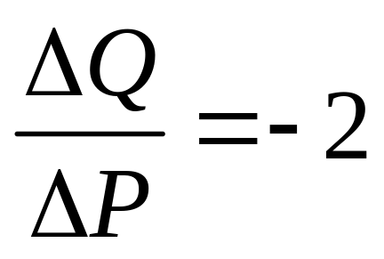
What is the effect of a small change ΔP in the price of the good on Q?
• ΔQ = Change in Demand
= [25+3Y+P⁰-2(P+ΔP)] – [25+3Y+P⁰-2P] = -2ΔP
or

Slide 16
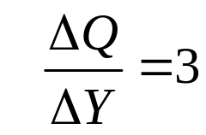
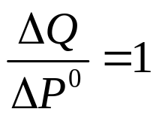
What is the effect of a small change ΔP in the price of the good on Q?
• ΔQ = Change in Demand
= [25+3Y+P⁰-2(P+ΔP)] – [25+3Y+P⁰-2P] = -2ΔP
or
The SLOPE of the Demand determines this!
The other slopes will also be important to us.

Slide 17
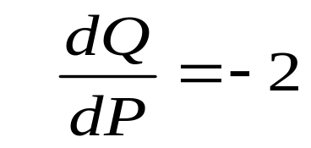
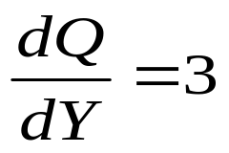
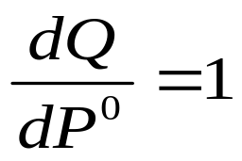
You Can Also Use Calculus : A Better Approach
You can also use calculus to measure the effect of an increase in price, or incomes or competitor’s price.

Slide 18
Response to Own Price
This is negative - almost all goods have this property = Law of Demand.

Slide 19
Response to Own Price
This is negative - almost all goods have this property = Law of Demand
It often seems as if this is not the case people are more willing to buy a $5000 Honda Accord than a $500 Honda Accord but in this case Price is signaling quality also.

Slide 20
Response to Income
Normal goods – Demand is increasing in income.

Slide 21
Response to Income
Normal goods – Demand is increasing in income.
Inferior goods – Demand is decreasing with income (bus travel).

Slide 22
Response to Income
Normal goods – Demand is increasing in income.
Inferior goods – Demand is decreasing with income (bus travel).
Luxury goods – Demand is increasing so rapidly in income that an increasing proportion of income is spent on them.

Slide 23
Response to Other Prices
Substitutes: if more of good A is brought as the price of good B rises

Slide 24
Response to Other Prices
Substitutes: if more of good A is brought as the price of good B rises.
Complements: if less of good A is brought as the price of good B rises (gas and cars).

Slide 25
Response to Other Prices
Substitutes: if more of good A is brought as the price of good B rises
Complements: if less of good A is brought as the price of good B rises (gas and cars).
Exercise: Are the following substitutes or complements?
(ink ; paper), (a/c ; electricity),
(sleep ; leisure), (coke ; pepsi)
Question : Are the producers of complements in competition? Are the producers of substitutes in competition?

Slide 26
Graphing Demand 1: Price Changes
Let us assume that Y=105 and P⁰=240.
(Recall Q = 25+3Y+P⁰-2P)
So
Q = 580 -2P
Sometimes we also want to know what price it takes to sell a given quantity.
580 - Q = 2P
290 - 0.5 Q = P

Slide 27
Graph: 290 – 0.5Q = P
Price
290
P = 290 – 0.5 Q
P
Quantity
Q = 580 – 2P
580

Slide 28
Graphing Demand 2:
Other Changes
Recall Q =25 +3Y +Pº-2P, and Y is income
Suppose Y increases from 105 to 115 while Pº=240, then the new demand curve is
Q = 610 –2P

Slide 29
Shift in Demand
Price
305
290
Q = 580 – 2P
P
580
610
Quantity

Slide 30
Shift in Demand
Price
305
New Demand Q=610-2P
290
Q = 580 – 2P
P
580
610
Quantity

Slide 31
Summary
(1) A change in the price is a movement along an existing demand curve.

Slide 32
Summary
(1) A change in the price is a movement along an existing demand curve.
(2) A change in income, or other prices, or any other variable that influences the total quantity demanded shifts the demand relation.

Slide 33
Exercise
How will the demand curve of good x respond to a change in y?
x y
Vacations Income Potatoes Income

Slide 34
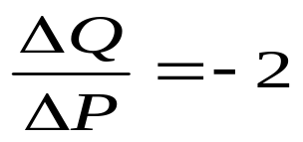
Price Elasticities
Question: How can we tell whether demand is, or is not, very responsive to price?
The ratio is not a good way.

Slide 35
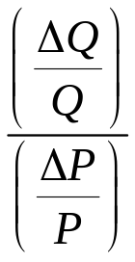
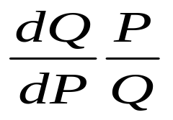
Price Elasticities
Question: How can we tell whether demand is, or is not, very responsive to price?
The ratio is not a good way.
A better measure is the % change in quantity divided by the % change in price
= = Elasticity of Demand

Slide 36
Notes
The price elasticity is usually negative.
e.g. A –3 elasticity means a 15% increase in price leads to a 45% fall in demand.
-3 = % Change in Q
% Change in Price

Slide 37
Notes
The price elasticity is usually negative.
e.g. A –3 elasticity means a 15% increase in price leads to a 45% fall in demand.
As the Elasticity becomes more negative –3 to –4 it becomes smaller and people are more sensitive to price increases.

Slide 38
Notes
The price elasticity is usually negative.
e.g. A –3 elasticity means a 15% increase in price leads to a 45% fall in demand.
As the Elasticity becomes more negative –3 to –4 it becomes smaller and people are more sensitive to price increases.
This sort of change is called a “more elastic” demand.

Slide 39
Notes
The price elasticity is usually negative.
e.g. A –3 elasticity means a 15% increase in price leads to a 45% fall in demand.
As the Elasticity becomes more negative –3 to –4 it becomes smaller and people are more sensitive to price increases.
This sort of change is called a “more elastic” demand.
A demand curve for a price-sensitive market is called “elastic”.

Slide 40
Notes
The price elasticity is usually negative.
e.g. A –3 elasticity means a 15% increase in price leads to a 45% fall in demand.
As the Elasticity becomes more negative –3 to –4 it becomes smaller and people are more sensitive to price increases.
This sort of change is called a “more elastic” demand.
A demand curve for a price-sensitive market is called “elastic”.
A demand curve for price-insensitive market is called “inelastic”.

Slide 41
Example: Demand for Newsprint in the USA
Q = 2672 - 0.51 P,
(Q = tons, P = $/ton)

Slide 42
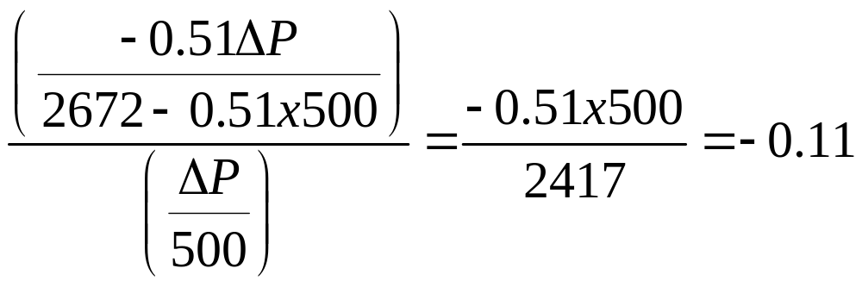
Example: Demand for Newsprint in the USA
Q = 2672 - 0.51 P, (Q = tons, P = $/ton)
The price for newsprint is $500, so the elasticity is
Question: Why is newsprint not price-sensitive?

Slide 43
What Determines Elasticities?
Closeness of substitutes (Coke & Pepsi).

Slide 44
What Determines Elasticities?
Closeness of substitutes (Coke & Pepsi).
How tightly defined goods are (Coke, Colas, Sodas, all beverages).

Slide 45
What Determines Elasticities?
Closeness of substitutes.
How tightly defined goods are (Coke, Colas, Sodas, all beverages).
Time (1973 and Gasoline Price) .

Slide 46
What determines Elasticities?
Closeness of substitutes (Pepsi & Coke).
How tightly defined goods are (Coke, Colas, Sodas, all beverages).
Time (1973 and Gasoline Price) .
Importance/frequency of the purchase (Candy Bars vs Cars).

Slide 47
What determines Elasticities?
Closeness of substitutes (Light Bulbs)
How tightly defined goods are (Coke, Colas, Sodas, all beverages)
Time (1973 and Gasoline Price)
Importance/frequency of the purchase (Candy Bars vs Cars)
National Taste (US TGI Friday vs Euro's)

Slide 48
Some Price Elasticities of Goods
Elasticity
Commodity SR LR (Date)
Clothing 0.90 2.90 1992
Gas (Household) 1.40 2.10 1980
Tobacco Products 0.46 1.89 1970
Electricity(Household) 0.13 1.89 1970
Wine 0.88 1.17 1992
Jewelry & Watches 0.41 0.67 1970
Gasoline 0.20 0.60 1984

Slide 49
Elasticities and Revenue Maximization
How does revenue change as prices rise
  Good News : Get more from what you sell.

Slide 50
Elasticities and Revenue Maximization
How does revenue change as prices rise
  Good News : Get more from what you sell.
  Bad News : Selling less at higher prices.
  Which effect dominates?
  When is it a good idea to raise prices?

Slide 51
Figure
Price
P
Quantity
Q

Slide 52
Figure
Price
P+ΔP
P
Quantity
Q
Q+ΔQ

Slide 53
Figure
Price
Revenue Gained
P+ΔP
P
Quantity
Q
Q+ΔQ

Slide 54
Figure
Price
Revenue Gained
P+ΔP
Revenue Lost
P
Quantity
Q
Q+ΔQ
Revenue Gained = ΔP (Q+ΔQ) approx ΔPQ
Revenue Lost = −ΔQ P

Slide 55
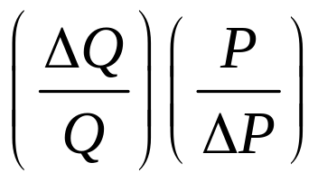
Gain > Loss,
ΔP Q > -ΔQ P
Re writing this equation it becomes
> -1.
That is, Demand Elasticity > -1

Slide 56
Summary
If elasticity > -1, then increasing prices increases revenue.
If elasticity < -1, then increasing prices decreases revenue.
If elasticity = -1 then you are maximizing revenue.

Slide 57
Question:
Could a sensible monopolist ever offer a price on the inelastic
(where elasticity of demand > -1) part of its demand curve?
Answer = No
By raising its price revenues go up and costs go down (it needs to
produce less)! The firm will always increase its profit by raising
its prices.
Revenue is always maximized when the elasticity = -1.

Slide 58
-1>Elasticity (Elastic)
Q = 1,600 –4P
-1 = Elasticity
-1<Elasticity(Inelastic)

Slide 59
-1>Elasticity (Elastic)
Q = 1,600 –4P
-1 = Elasticity
-1<Elasticity(Inelastic)
$160,000
Revenue
R=400Q-Q²/4

Slide 60
Different Elasticities
Use the right elasticity when pricing goods.
e.g. The demand for minivans is much less elastic than the
demand for Ford minivans.
The short run vs. long run elasticity of demand
Differing elasticity imply different optimal prices.
e.g. air travel from US to Europe has the elasticities
First class -.45
Regular Economy -1.3
Excursion -1.83

Slide 61
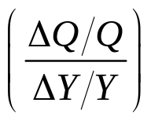
Other Elasticities:
The Income Elasticity is the % change in demand over the % change in income and is usually positive.
Commodity Income Elasticity (Date)
Wine 2.59 1992
Electricity (Household) 1.94 1970
Beef 1.06 1990
Beer 0.46 1990
Chicken 0.28 1990
Pork 0.14 1990
Flour -0.36 1970

Slide 62
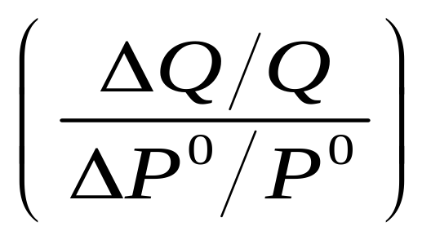
The Cross-Price Elasticity
The Cross-Price Elasticity is the % change in demand over the % change in another good’s price.
This measures how sensitive your demand is to your competitor’s prices.
This is important in internal decisions when you make many products,
Eg Volkswagen and Audi A4, VW Passat.
It is also measures how competitive the market is?

Slide 63
Example : Dupont
It was referred to the FTC because it had a large share of the market for plastic wraps.
Showed that waxed paper and aluminum foil had high cross-price elasticities with plastic wraps and so only actually had 20% of the total market.

Slide 64
Cross price elasticity
with respect to CPElast
Margarine Butter 1.53
Natural Gas Electricity 0.80
Pork Beef 0.40
Chicken Pork 0.29
Clothing Food 0.18
Entertainment Food -0.72
Cereals Fresh Fish -0.87

